Slide 1
6 Ways to Prevent Code Abuse
Michael L Perry

Slide 2



Michael L Perry
qedcode.com
@MichaelLPerry
https://github.com/michaellperry/ Provable-APIs

Slide 3
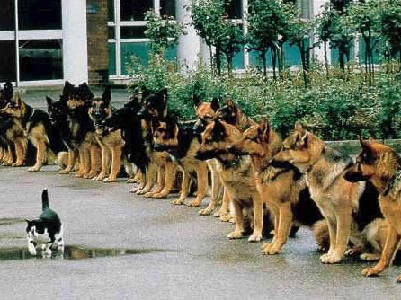
Confidence
Notes:
http://www.globalnerdy.com/2007/02/06/living-dangerously-with-vista-itunes-and-the-ipod/

Slide 4
Ways to Gain Confidence
Manual Testing
Code Reviews
Unit Testing
Quality Metrics
Continuous Integration

Slide 5
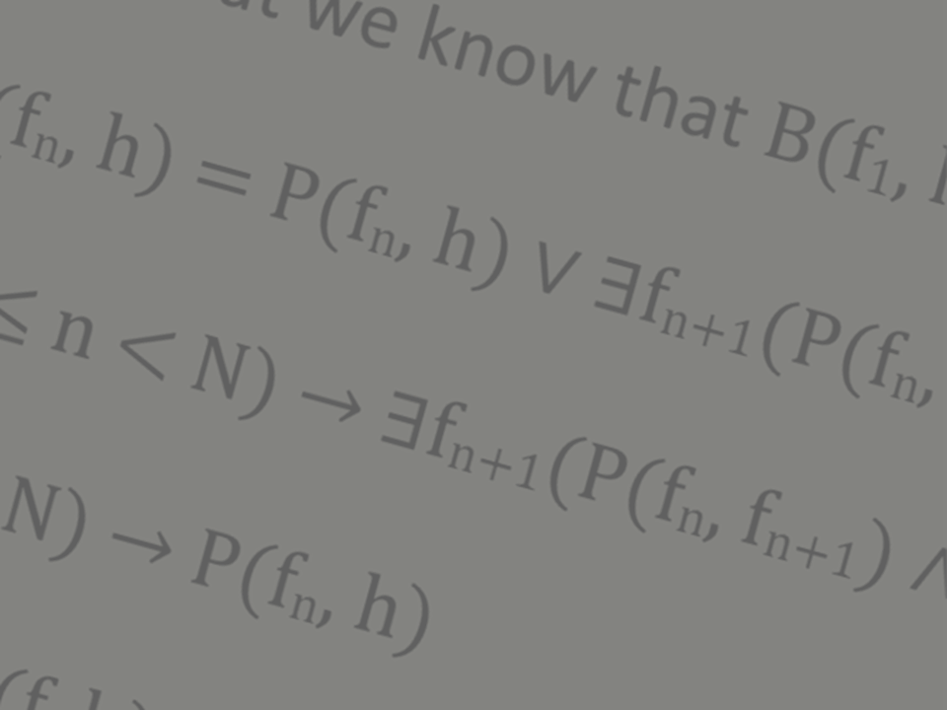
Mathematical Proof

Slide 6
Prevent Code Abuse
APIs are intended for others to call
Their problem becomes yours
You cannot test their work
Guide others to correct use

Slide 7
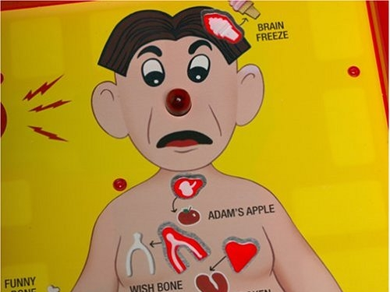
Exceptions
Notes:
http://aroundthesphere.wordpress.com/2009/07/14/organs-urgency-money-and-reform/

Slide 8
Make it impossible
Parameters
Callbacks
Factories
Constructors
Immutability
Monads

Slide 9
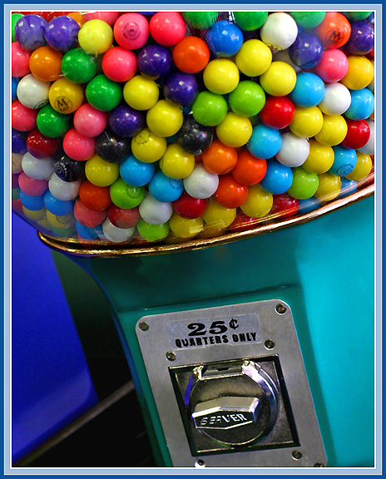
Parameters
Notes:
http://michaelweinberg.com/5new-hitparade1.html

Slide 10
One thing must be done before something else

Slide 11
YourAPI yourApi = new YourAPI();
yourApi.DoThisFirst();
yourApi.DoThisSecond();

Slide 12
YourAPI yourApi = new YourAPI();
var result = yourApi.DoThisFirst();
yourApi.DoThisSecond(result);

Slide 13

Callbacks
Notes:
http://www.visitingdc.com/city/hollywood-sign-address.asp

Slide 14
Something is done between two functions

Slide 15
YourAPI yourApi = new YourAPI();
yourApi.DoThisFirst();
DoThisInTheMiddle();
yourApi.DoThisLast();

Slide 16
YourAPI yourApi = new YourAPI();
yourApi.DoThis(delegate
{
DoThisInTheMiddle();
});

Slide 17

Constructors
Notes:
http://www.virtualworldlets.net/Resources/Hosted/Resource.php?Name=Lightcycles
Copyright Walt Disney

Slide 18
Something is done once and only once

Slide 19
YourAPI yourApi = new YourAPI();
yourApi.DoThisOnce("value");
yourApi.DoThisRepeatedly();
yourApi.DoThisRepeatedly();

Slide 20
YourAPI yourApi =
new YourAPI("value");
yourApi.DoThisRepeatedly();
yourApi.DoThisRepeatedly();

Slide 21
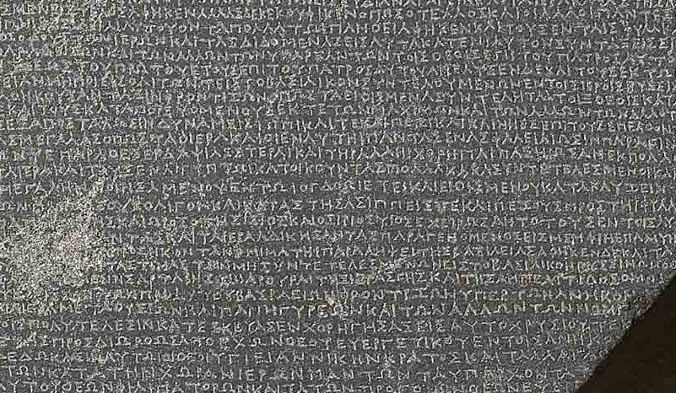
Immutability

Slide 22
Nothing has changed in the interim

Slide 23
YourAPI yourApi = new YourAPI();
yourApi.SetThis = "value";
yourApi.UseIt();
yourApi.ExpectItToBeTheSame();

Slide 24
YourAPI yourApi =
new YourAPI("value");
yourApi.UseIt();
yourApi.ExpectItToBeTheSame();

Slide 25

Factories

Slide 26
An argument meets a condition

Slide 27
YourAPI yourApi = new YourAPI();
YourObject obj = new YourObject();
obj.Property = "value";
if (obj.MeetsSomeCondition)
{
yourApi.Accept(obj);
}

Slide 28
YourAPI yourApi = new YourAPI();
var obj = YourObject
.GenerateValidObject("value");
yourApi.Accept(obj);

Slide 29
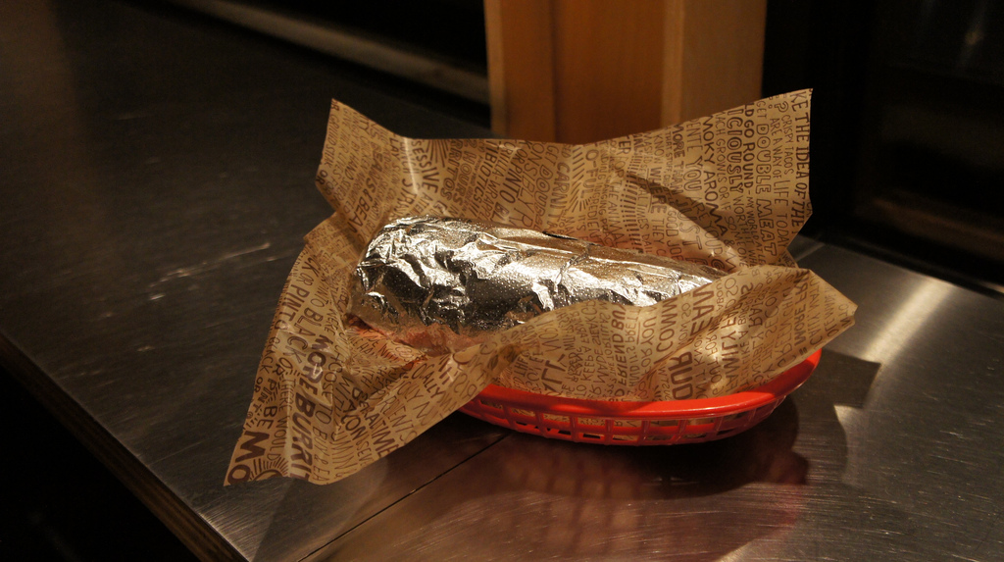
Monads
Notes:
https://www.flickr.com/photos/z0/5116389006
Bring the world of side-effects under the control of compositionality

Slide 30
Special cases are considered

Slide 31
YourAPI yourApi = new YourAPI();
if (!yourApi.Step1())
HandleCondition1();
try
{
var value = yourApi.GetValue();
ProcessValue(value);
}
catch (Exception ex)
{
HandleCondition2();
}

Slide 32
YourAPI.Begin()
.Bind(ProcessValue)
.OnCondition1(HandleCondition1)
.OnCondition2(HandleCondition2);

Slide 33
Constructors
Parameters
Callbacks
Monads
Immutability
Factories

Slide 34

Paradox of Constraints

Slide 35
Michael L Perry
qedcode.com
@MichaelLPerry
https://github.com/michaellperry/ Provable-APIs

